Slide 1

welcome Project Title: Crafting Compelling Web Presences

Slide 2

what is crafting compelling web presence?
Crafting Compelling Web Presences
The understanding your target audience, creating a visually appealing layout, optimizing for mobile devices, focusing on user experience, and incorporating social proof, you can design an effective online presence that attracts and engages your ideal customers.

Slide 3

1. First Impressions Matter 2. 24/7 Accessibility 3. Central Hub for Information 4. Enhanced Visibility 5. Effective Marketing Tool 6. Measurable Results 7. Mobile Responsiveness 8. Builds Brand Authority 9. Engagement and Interaction 10. Competitive Advantage
the importance of websites in digital marketing:

Slide 4

1. First Impressions Matter
A website is often the first point of contact for potential customers. A well-designed and user-friendly website creates a positive first impression, instilling trust and credibility in your brand.

Slide 5
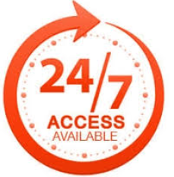
2. 24/7 Accessibility
Unlike traditional brick-and-mortar stores, a website is accessible round the clock, allowing customers to engage with the brand and make purchases at their convenience, irrespective of time zones or geographical locations.

Slide 6

3. Central Hub for Information
A website serves as a central repository of information about products, services, and brand story. It provides customers with detailed insights into what we offer, helping them make informed purchasing decisions.

Slide 7

4. Enhanced Visibility
A properly optimized website improves visibility in search engine results, making it easier for potential customers to find online. Implementing SEO strategies ensures that the website ranks higher, driving organic traffic and increasing brand visibility.

Slide 8
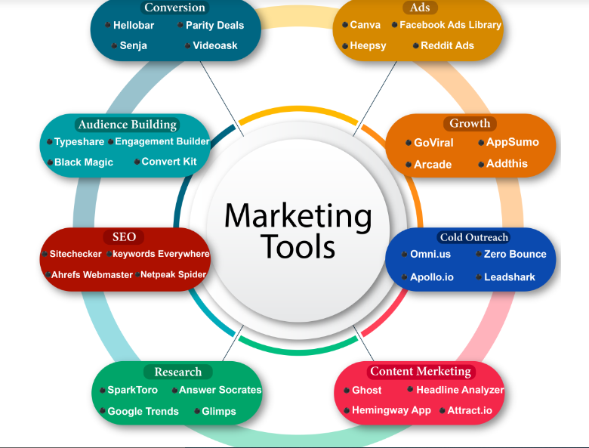
5. Effective Marketing Tool
A website serves as a powerful marketing tool, enabling us to showcase products or services, run promotional campaigns, and capture leads through contact forms or subscription lists.

Slide 9

6. Measurable Results
With tools like Google Analytics, we can track and measure the performance of the website, gaining valuable insights into visitor behavior, traffic sources, and conversion rates. This data helps us refine digital marketing strategies for better results.

Slide 10
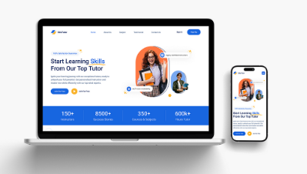
7. Mobile Responsiveness
In today's mobile-centric world, having a responsive website that adapts seamlessly to various devices is essential. Mobile-friendly websites not only provide a better user experience but also improve search engine rankings.

Slide 11

8. Builds Brand Authority
A professionally designed website with high-quality content positions the brand as an authority in the industry. Regularly updating the website with informative blogs, case studies, or whitepapers helps establish credibility and trust among the audience.

Slide 12

9. Engagement and Interaction
Websites offer interactive features such as live chat, social media integrations, and comment sections, fostering engagement and interaction with the audience. This two-way communication enhances customer satisfaction and loyalty.

Slide 13
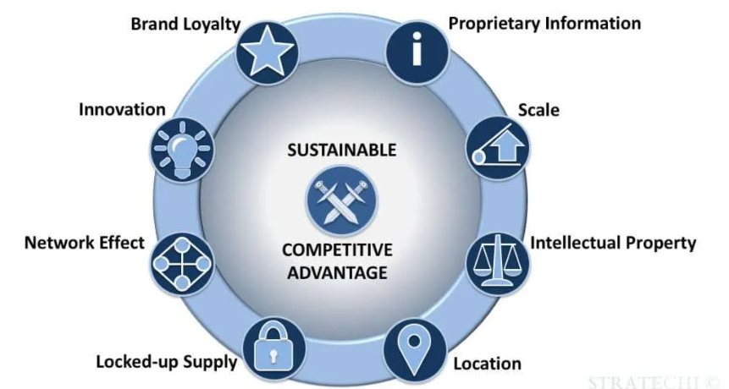
10. Competitive Advantage
In today's competitive market, having a well-optimized and engaging website sets you apart from competitors. It allows us to showcase unique selling propositions and differentiate the brand, ultimately driving business growth and success in the digital landscape.

Slide 14

Landing Page(LP) Design
https://www.ladiart&design.com/

Slide 15


